Slide 1

Evaluation of Various Sensing Modalities for Accurate Measurement of Neck Flexion Angle during Thyroid and Ear Surgery
Team Member : Zhen Hu, Hanqing Duan
Mentor: Dr. Russell Taylor, Dr. Deepa Galaiya

Slide 2
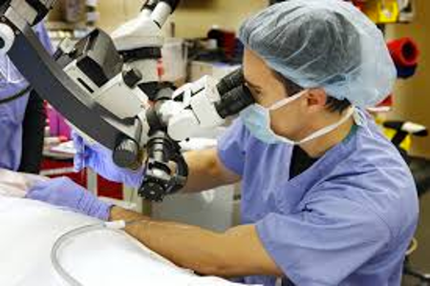
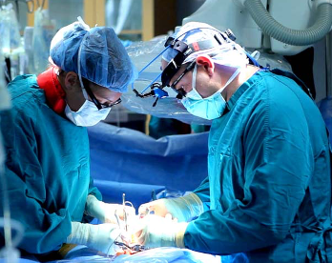
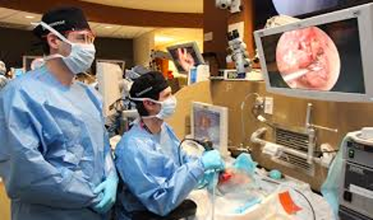
Background
Ear Surgery
Traditional case: looking through microscopes
Endoscopic case: looking at monitor
Thyroid Surgery
Traditional case: standing over patient
Endoscopic case: looking straight at a monitor
Pictures from：https://oklahoman.com/gallery/articleid/3808606/
http://amandeepmedicity.org/specialities/bariatric-metabolic-surgery
http://www.tristonekidneyhospital.com/index.html
Notes:
介绍两种手术
医生站立时间过久
所以重要

Slide 3
Significance
Poor surgical ergonomics may lead surgeon disability
–2/3 of respondents reported neck discomfort related to their occupation–94% of surgical residents have musculoskeletal pain [1]
–Prevalence of musculoskeletal symptoms in the neck and shoulders is as high as 87% [2]
–Back pain most common
1.Khansa I, Khansa L, Westvik TS, Ahmad J, Lista F, Janis JE. Work‐related musculoskeletal injuries in plastic surgeons in the United States, Canada, and Norway. Plast Reconstr Surg. 2018;141(1):165e‐175e.
2.Capone AC, Parikh PM, Gatti ME, Davidson BJ, Davison SP. Occupational injury in plastic surgeons. Plast Reconstr Surg. 2010;125(5):1555‐1561.
Notes:
Show advantages of endoscopic surgery
Use these data to correct surgeons’ posture

Slide 4
Goals
Evaluation of Various Sensing Modalities for Accurate Measurement of Neck Flexion Angle during Thyroid and Ear Surgery using IMUs.
Notes:
To investigate and compare postural ergonomics of surgeons during two different surgical scenarios

Slide 5

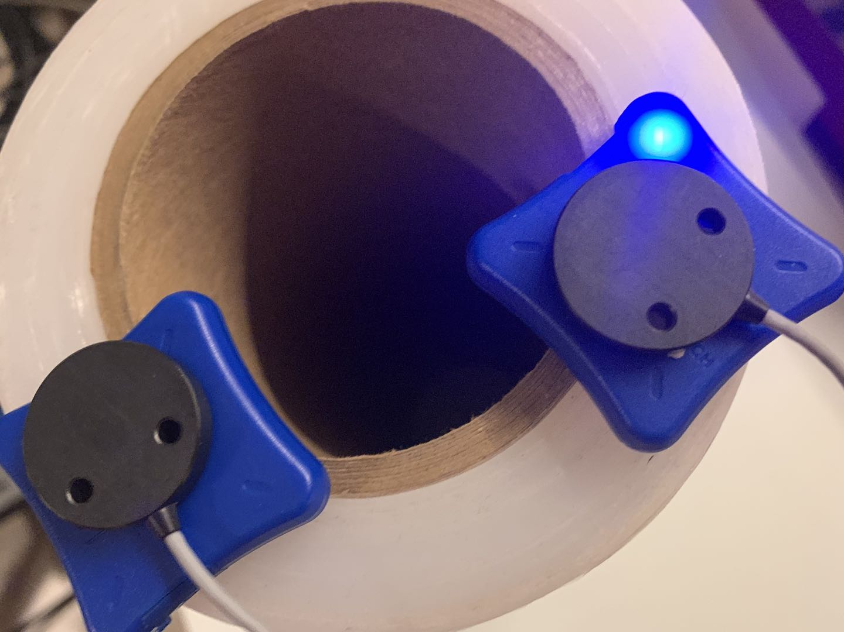



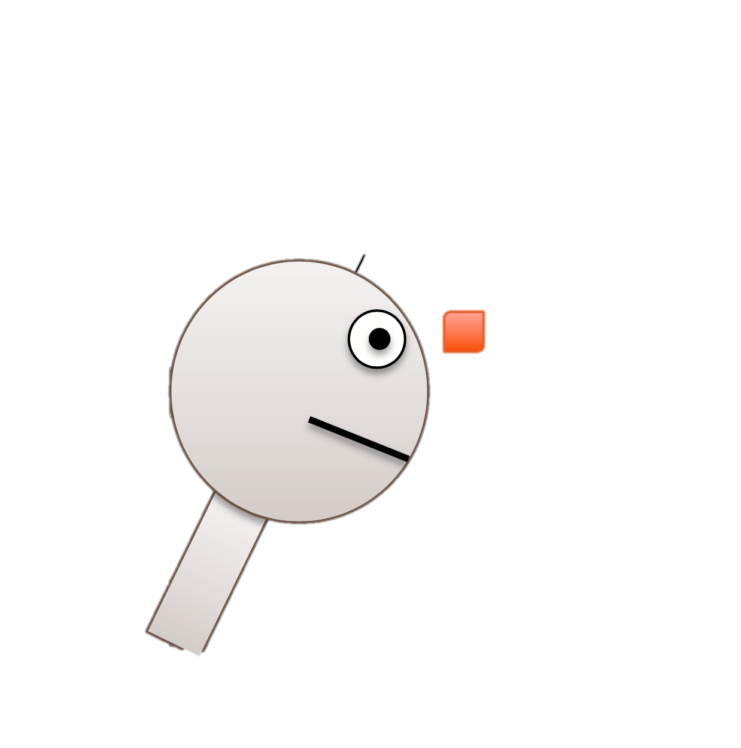
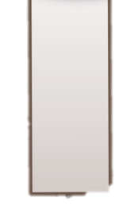


Technical Approach
IMU: Inertial measurement unit
3-axis gyroscope
3-axis accelerometer
3-axis magnetometer
EM tracker: Electromagnetic tracker
-- External ground truth system
Calibrate every IMU by the ground truth;
Derive pitch angle from 6 sensors data;
Validate the pitch angle.
Calibrate IMUs
with EM trackers
Setup Software
Environment
Derive Physical
Models
System: Linux & ROS
Package: lpms-imu;
ndi_tracker_ros
$$θ$$
Right Lower Figure Edit from: https://stanford.edu/class/ee267/lectures/lecture10.pdf

Slide 6
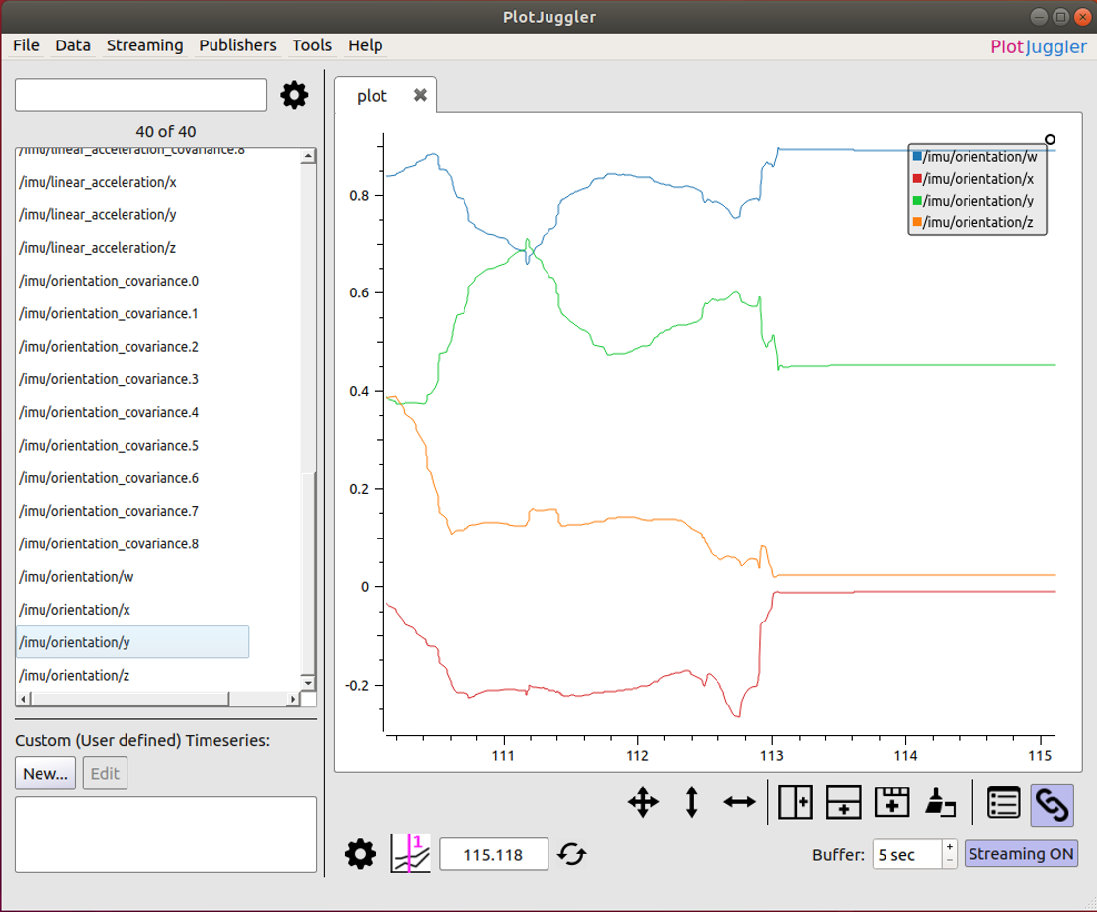


Technical Approach
Calibrate IMUs
with EM trackers
Analyze Angles
and Changes
Collect Data
from Mock Surgery
Setup Software
Environment
Derive Physical
Models
Data stores in rosbag file, and analyze using MATLAB
Signal processing, like Kalman filter, if needed
Calculate neck flexion angle from mathematical model
We will be interested in such data:
The largest angle
The angle last for a long time

Slide 7


Technical Approach
Calibrate IMUs
with EM trackers
Analyze Angles
and Changes
Write
Clinical Paper
Collect Data
from Mock Surgery
Setup Software
Environment
Derive Physical
Models
Collect Clinical Data
from Different Surgeries
Total 20 surgeries
Method:
Traditional
Endoscopic
We will be interested in comparison among these 8 different scenarios
Surgeon:
Young
With Expertise
Surgery:
Ear
Thyroid

Slide 8
Technical Approach
Calibrate IMUs
with EM trackers
Analyze Angles
and Changes
Write
Clinical Paper
Collect Data
from Mock Surgery
Setup Software
Environment
Derive Physical
Models
Collect Clinical Data
from Different Surgeries
Total 20 surgeries
Method:
Traditional
Endoscopic
We will be interested in comparison among these 8 different scenarios
Surgeon:
Young
With Expertise
Surgery:
Ear
Thyroid

Slide 9
Deliverables
Minimum: (Expected before Mar.6)
Calibration result of two IMUs separately against EM tracker (excel file)
Validation result of the pitch angle (excel file)
Documentation of software setting and calibration steps (doc file)
Expected: (Expected before Mar.12)
Data analysis report of phantom study
Maximum: (Expected before May.5)
Data analysis report of real surgical scenarios
Clinical paper

Slide 10
Time schedule
 | Feb,15 -Feb,21 | Feb,22-Feb, 28 | Feb,29-Mar, 6 | Mar,7-Mar,11 | Mar,12-Mar,20 | Mar,21-Mar,27 | Mar,28-Apr,3 | Apr,4 - Apr,10 | Apr,11-Apr,17 | Apr,18-Apr,24 | Apr,25-May,1 | May,1-May,5
Set up the computer and document installation steps (Zhen and Hanqing) | ✅ | ✅️ | ✅
Calibration and document steps (Hanqing) Derive mathematical model of neck angle and document steps (Zhen) |  | ☑️ | ☑️
First measurement in Mock OR & First data analysis (Zhen and Hanqing) |  |  |  | ☑️
Human Subjects Research Training and IRB approval | ☑️ | ☑️ | ☑️ | ☑️
20 measurement in real surgery scenarios & Each one do data analysis (Zhen and Hanqing) |  |  |  |  | ☑️ | ☑️ | ☑️ | ☑️ | ☑️
Overall analysis and documentation of the difference between various scenarios (Zhen and Hanqing) |  |  |  |  |  |  |  | ☑️ | ☑️ | ☑️
Write clinical paper (Zhen and Hanqing) |  |  |  |  |  |  |  |  |  | ☑️ | ☑️ | ☑️
✅ : Finished stuff ☑️ : Planned stuff

Slide 11
Milestones
Date | Detailed Description
February, 21 | Linux and ROS environment configuration finished
February, 26 | Project proposal finished
February, 26 | Human Subjects Research Training finished
March, 6 | Calibration of IMUs and mathematic model derivation finished
March, 6 | Documentation of environment configuration and calibration method finished
March, 11 | IRB approval
March, 11 | First measure in Mock OR and analysis of the data finished
April, 17 | 20 measurements in real surgery and analysis of the data finished
April, 24 | Analysis of the difference between various surgery scenarios finished
April, 24 | Documentation of data collection and data analysis finished
May, 4 | Clinical paper finished

Slide 12
Dependencies
Dependencies | How to resolve | Alternative Plan | Date Expected | Date Needed
IRB approval | 1. Finish Human Subjects Research Training on Mylearning 2. Get IRB approval with the help of Dr. Deepa Galaiya | Do all the measurement in Mock OR | 1. Feb,24 2. Mar,6 | 1. Feb,26(Solved) 2. Mar,11(In progress)
Computer with Linux & ROS | 1. Our own computers for calibration 2. Another computer for data collection sponsored by Dr. Taylor, discussed with Deepa and Anton | Use backup files in another computer | 1. Feb, 14 2. Mar, 6 | 1. Feb,19th (Solved ) 2. Mar,12th (Solved)
Two IMUs | Provided by Dr. Deepa Galaiya | Buy two new IMUs sponsored by Dr. Taylor, discussed with Anton | Feb, 14 | Feb,19 (Solved)
IMU related software in Linux (Packages included Lpms-imu and ndi_tracker_ros) | Installation from Galen-Trackers GitLab with the help of Anton | In Windows, install Lpms_control Software | Feb,19 | Feb,21 (Solved)
EM tracker for Calibration | Get the access to Mock OR | Optical Tracker | Feb, 19 | Feb,21 (Solved)
Phantom study data | Deepa do mock surgery in Mock OR | With the help of graduate student | Mar,1 | Mar,6 (Not start)
Actual surgery data | Get data from Samuel who is responsible for collecting actual surgery data in medical school | Do all the measurement in Mock OR | Mar,10 | Mar,12 (Not start)
MATLAB for data analysis Dropbox for data saving | Installation | Python Google drive | Mar,1 | Mar,6 (Solved)

Slide 13
Management & Contribution
Attend the group meeting with Dr. Taylor weekly
Make appointments ahead of time and discuss with Deepa weekly
Weekly meeting between Hanqing and Zhen every Monday evening
Make appointments with Anton if needed
Hanqing and Zhen will do preparation work and the first data analysis together for the phantom study in Mock OR. When the real study in OR starts, we will do data analysis individually.

Slide 14
Reading List
Du, Y., Shih, C., Fan, S. et al. An IMU-compensated skeletal tracking system using Kinect for the upper limb. Microsyst Technol 24, 4317–4327 (2018).
Islam, Tariqul, et al. "Comparison of complementary and Kalman filter based data fusion for attitude heading reference system." AIP Conference Proceedings. Vol. 1919. No. 1. AIP Publishing LLC, 2017.
Won, Seong-hoon, William Melek, and Farid Golnaraghi. "Position and orientation estimation using Kalman filtering and particle diltering with one IMU and one position sensor." 2008 34th Annual Conference of IEEE Industrial Electronics. IEEE, 2008.
Lakhiani C, Fisher SM, Janhofer DE, Song DH. Ergonomics in microsurgery. J Surg Oncol. 2018;118(5):840–844. doi:10.1002/jso.25197
Vaisbuch Y, Aaron KA, Moore JM, et al. Ergonomic hazards in otolaryngology. Laryngoscope. 2019;129(2):370–376. doi:10.1002/lary.27496
Wong K, Grundfast KM, Levi JR. Assessing work-related musculoskeletal symptoms among otolaryngology residents. Am J Otolaryngol. 2017;38(2):213–217. doi:10.1016/j.amjoto.2017.01.013
Wang R, Liang Z, Zihni AM, Ray S, Awad MM. Which causes more ergonomic stress: Laparoscopic or open surgery?. Surg Endosc. 2017;31(8):3286–3290. doi:10.1007/s00464-016-5360-5
Zihni AM, Cavallo JA, Ray S, Ohu I, Cho S, Awad MM. Ergonomic analysis of primary and assistant surgical roles. J Surg Res. 2016;203(2):301–305. doi:10.1016/j.jss.2016.03.058
Nguyen NT, Ho HS, Smith WD, et al. An ergonomic evaluation of surgeons' axial skeletal and upper extremity movements during laparoscopic and open surgery. Am J Surg. 2001;182(6):720–724. doi:10.1016/s0002-9610(01)00801-7

